Slide 1




Smart City Energy Optimization
& Prediction Platform
Presenter: Team 4
Nagat Osama | Merna Sameh | Ebrahim Ateff | Abdullah Mohamed
Supervised by: Eng. Ahmed Ali
11/30/25
1

Slide 2






Project Vision
The Problem
The Solution
Unique Value
Modern cities face unpredictable energy spikes due to rapid growth that costs cities millions annually. Weather conditions and traffic congestion significantly impact grid instability, leading to inefficiencies.
An automated Azure platform integrating Energy, Weather, and Traffic data. Utilizing Medallion Architecture (Raw → Bronze → Silver → Gold) for robust processing.
Proactive Optimization: Not just reporting, but identifying "Risk Zones" and providing actionable load-shifting recommendations before outages occur.
11/30/25
2

Slide 3

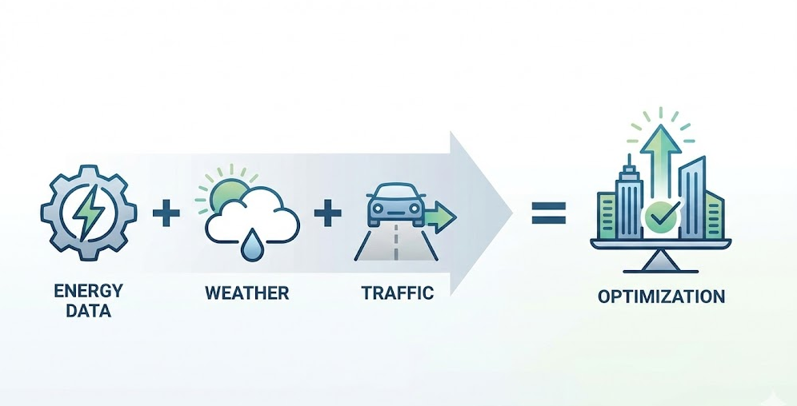
Project Idea
A cloud-native "End-to-End Data Platform" on Azure that integrates batch energy data with real-time weather/traffic APIs to accurately forecast consumption.
11/30/25
3

Slide 4

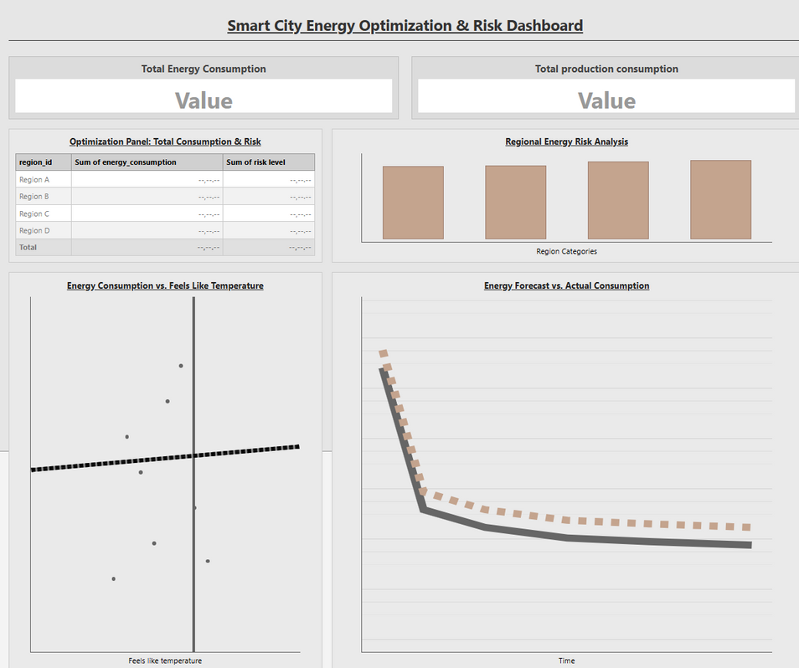
Project Wireframe & User Journey
User Journey
Monitor: Grid Operator logs in to view real-time grid status and total consumption vs. production.
Detect: System flags "High Risk Zones" (Red) where predicted demand > capacity.
Optimize: User reviews the "Optimization Panel" for specific actions (e.g., "Shift Load in Region R3").
11/30/25
4

Slide 5




Users & Core Features
Target Audience
Key Features
City Planners: Need long-term trends to plan infrastructure expansion and sustainability goals.
Energy Forecasting: Predicts consumption with high precision using Azure ML (ARIMA/Prophet).
Risk Identification: Automatically identifies regions exceeding historical peak capacity.
Grid Operators: Need granular, hourly forecasts to manage immediate load stability and prevent outages.
Optimization Engine: Suggests resource balancing strategies (peak shifting) to mitigate risks.
11/30/25
5

Slide 6
System Architecture
Data Sources: Integration of Batch CSVs and Real-time External APIs (Weather, Traffic).
AI Modeling: Azure ML Designer for forecasting and risk classification.
Ingestion & Processing: Azure Data Factory for orchestration and Databricks for transformation.
Visualization: Synapse SQL Views powering interactive Power BI dashboards.
11/30/25
6

Slide 7



Medallion Data Architecture
Raw Layer
Bronze Layer
Silver Layer
Gold Layer
Stores original data exactly as received (CSVs) for audit and backup.
Standardized data with added metadata columns (Load Date, Source System).
Cleaned, de-duplicated data with feature engineering (Weather Index, Flags).
Aggregated, business-ready data (Forecasts, Risk Scores) for BI & Analytics.
11/30/25
7

Slide 8
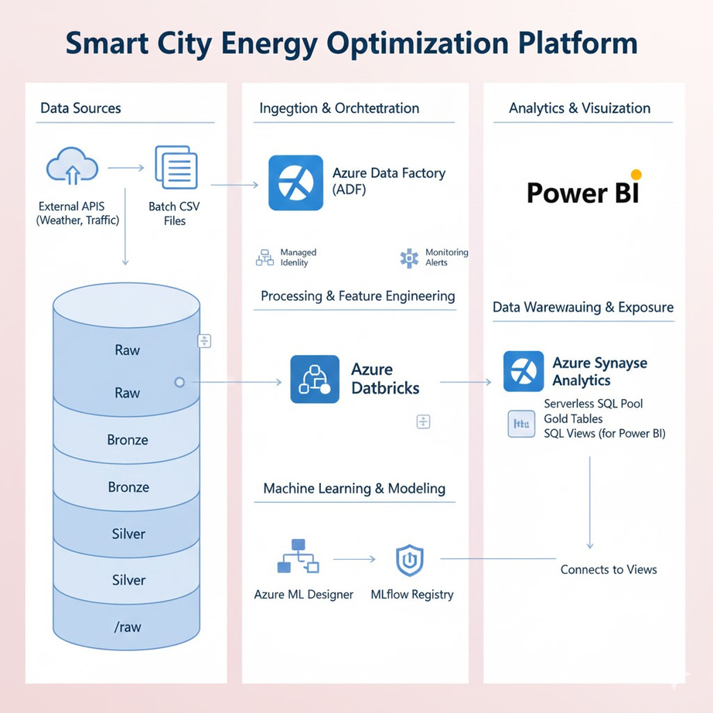
Data Structure: Medallion Architecture
Key Entities
Energy: Timestamp, Meter_ID, Consumption (kWh).
Weather: Temp, Humidity, Wind Speed.
Traffic: Congestion Index, Speed.
11/30/25
8

Slide 9






Languages & Frameworks
Languages
Core Frameworks
AI & Analytics
Python (PySpark): Used in Databricks for complex ETL and Feature Engineering.
Azure Data Factory: Orchestration pipelines.
Azure ML Designer: Visual ML pipelines.
Azure Databricks: Big Data processing.
MLflow: Model lifecycle management.
SQL: Used in Synapse Serverless Pools for creating reporting views.
Delta Lake: ACID transactions.
Power BI: Interactive visualization.
11/30/25
9

Slide 10
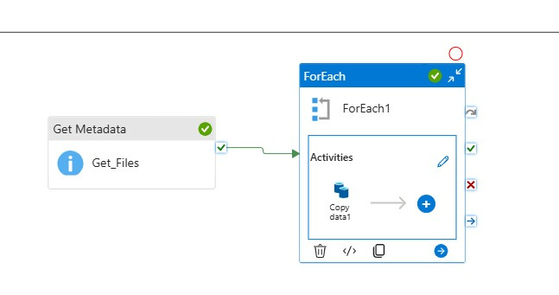
Ingestion Pipelines
Presenter: Nagat Osama
Pipeline 1 (Energy): Ingests daily batch CSV files into ADLS Raw and promotes to Bronze.
11/30/25
10

Slide 11
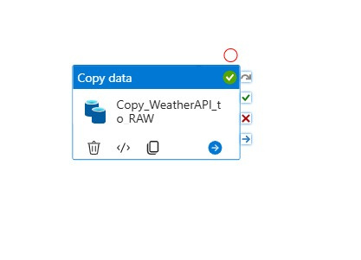
Ingestion Pipelines
Presenter: Nagat Osama
Pipeline 2 (Weather): Fetches real-time REST API data, handling JSON responses.
11/30/25
11

Slide 12
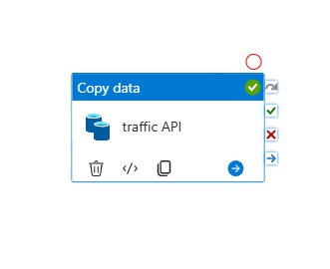
Ingestion Pipelines
Presenter: Nagat Osama
Pipeline 3 (Traffic): Captures live congestion data via API for correlating load spikes.
11/30/25
12

Slide 13
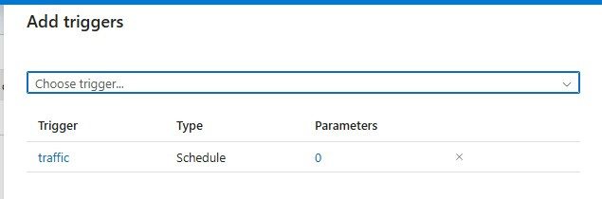
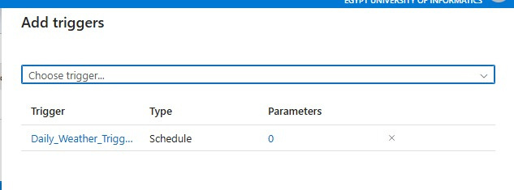
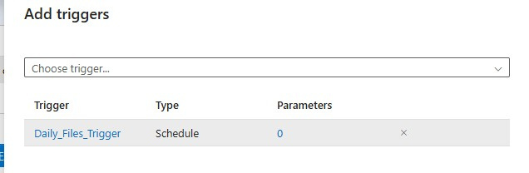
Ingestion Pipelines
Presenter: Nagat Osama
11/30/25
hourly triggers
11/30/25
13

Slide 14
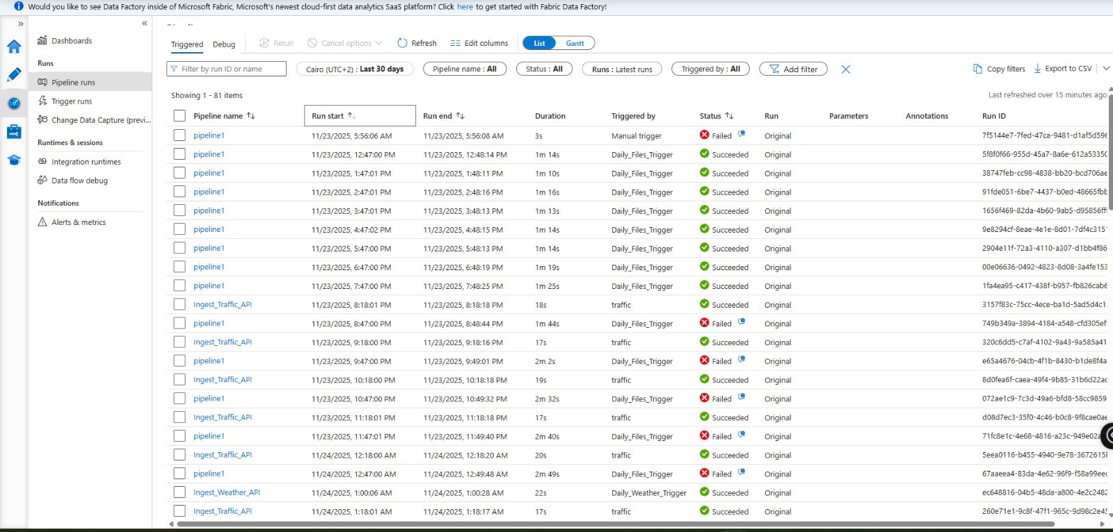
Ingestion Pipelines
Presenter: Nagat Osama
11/30/25
14

Slide 15


Data Processing (Silver Layer)
Presenter: Ebrahim Ateff
Data Cleaning
Transformation
Implemented PySpark logic to remove duplicates and handle missing values using mean imputation. This ensures high-quality input for the ML models.
Weather: Exploded complex JSON arrays to align history.
Traffic: Flattened nested structures to calculate congestion indices.
Master Table: Joined all sources into silver.smartcity_master.
11/30/25
15

Slide 16



Data Processing (Silver Layer)
Presenter: Ebrahim Ateff
Data Cleaning Steps
Transformation
1. Mount & Load: Read raw data from ADLS.
2. Deduplication: Used dropDuplicates().
3. Validation: Cast string timestamps to TimestampType.
4. Null Handling: Applied Mean Imputation for missing values.
Flattening: Used explode() and arrays_zip() for nested JSON.
Feature Eng: Created peak_hour_flag (17:00-22:00) & weekend_flag.
Integration: Joined Energy + Weather + Traffic on timestamp.
11/30/25
16

Slide 17
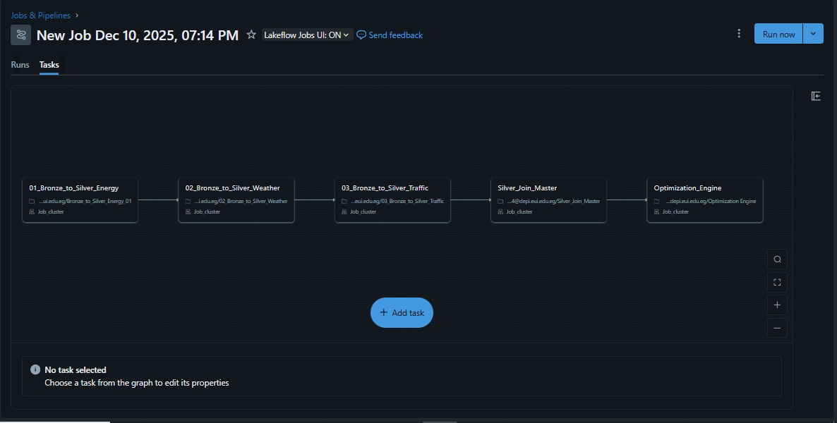
Data Processing (Silver Layer)
Presenter: Ebrahim Ateff

Slide 18
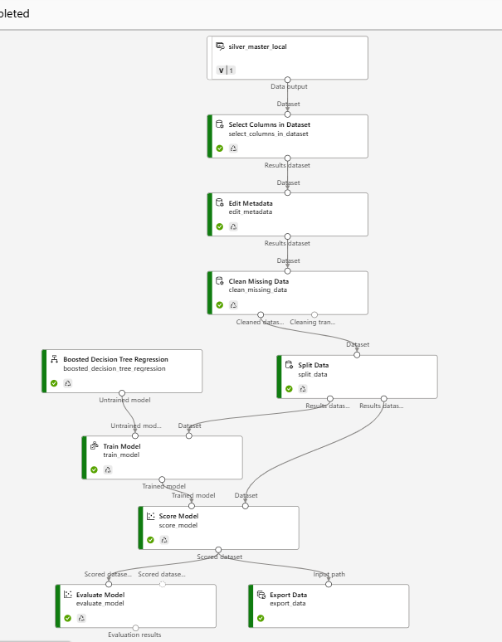
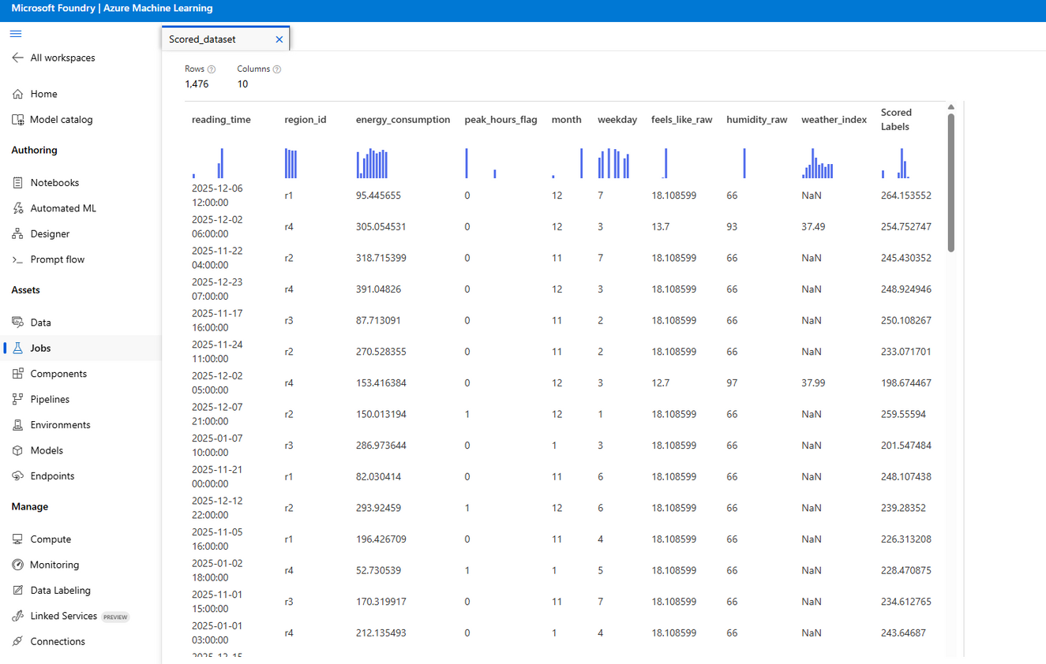
Forecasting & AI Models
Presenter: Abdullah Mohamed
11/30/25
17

Slide 19

Forecasting & AI Models
Presenter: Abdullah Mohamed
Data Strategy: Split historical data into 80% Training and 20% Testing sets for validation.
Gold Outputs:
- gold.energy_forecast: Hourly predictions.
- gold.risk_zones: Risk classification.
- gold.optimization: Load shifting logic.
Models: Trained ARIMA and Prophet models on the Silver Master table to predict demand.
11/30/25
18

Slide 20
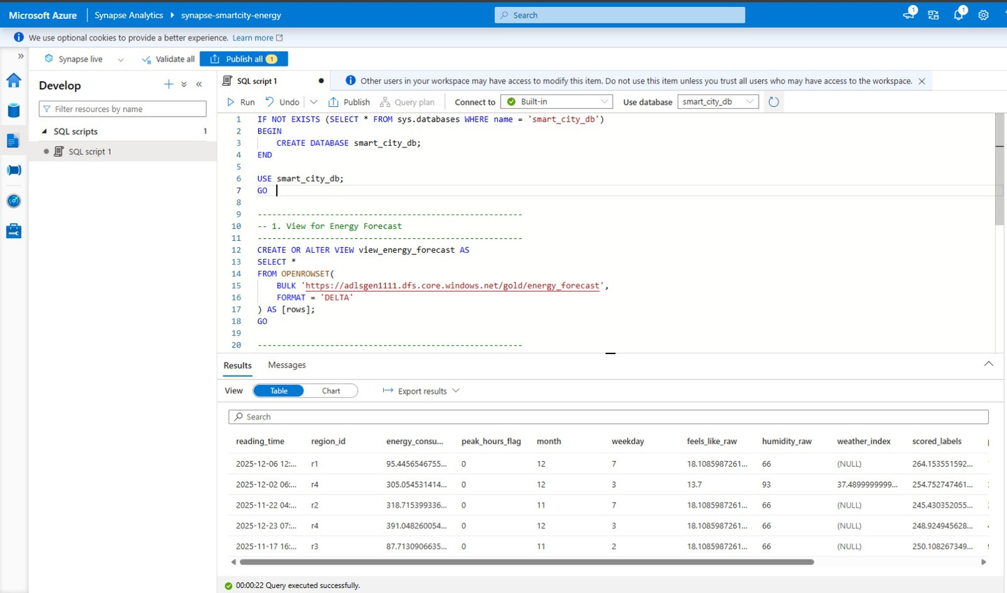
Presenter: Abdullah Mohamed
Forecasting & AI Models
Creating the Serving Layer:
We utilized Azure Synapse Serverless SQL Pools to create a virtual layer over our data.
The script uses the CREATE VIEW command to define a schema for the ML output (energy_forecast).
Data Virtualization (OPENROWSET):
We used the OPENROWSET function to query Parquet/Delta files directly from ADLS Gen2 without moving the data.
This converts raw file paths into a structured SQL table format that Power BI can easily understand.
Seamless Integration:
This view acts as the connector. Power BI connects to this view via "DirectQuery" or "Import" mode to visualize the scored_labels (predictions) alongside actual_consumption.
11/30/25
19

Slide 21
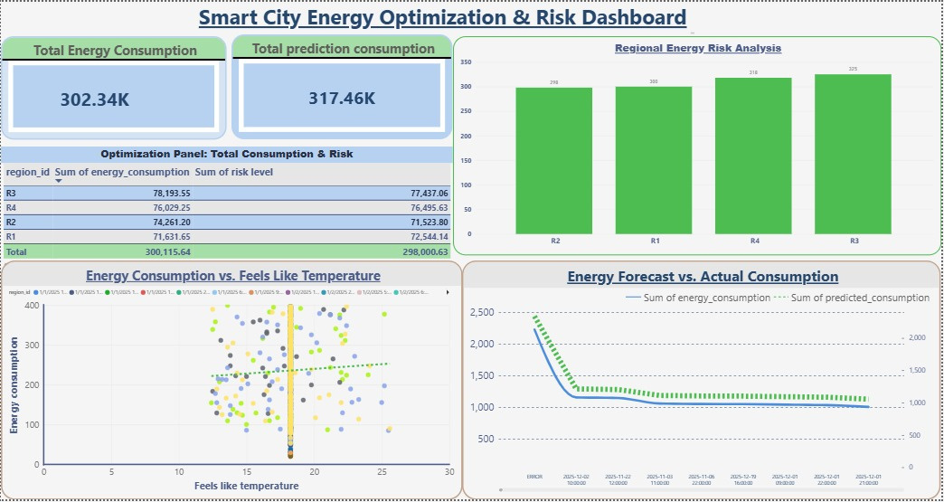
Power BI Integration
Presenter: Merna Sameh
Synapse Integration: Leveraged Serverless SQL Views (view_energy_forecast) to expose Gold data securely to Power BI.
Key Visuals:
- Regional Energy Risk Analysis map.
- Forecast vs. Actual Consumption trends.
Impact: Provides decision-makers with a real-time view of grid health and optimization opportunities.
11/30/25
20

Slide 22
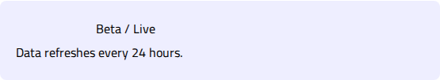
Live Application Status & Testing
Testing Phases
Production Ready
•
Unit Testing: Validated schema enforcement and data types within Databricks notebooks.
The system is fully deployed on Azure. Pipelines run daily, ingesting new data and updating the Power BI dashboard automatically.
•
Integration Testing: Successful end-to-end execution of ADF pipelines (Ingest -> Process -> Train -> Report).
Current State:
•
Model Evaluation: Forecasts evaluated using RMSE and MAPE metrics; successfully predicted historical peak events.
11/30/25
21

Slide 23
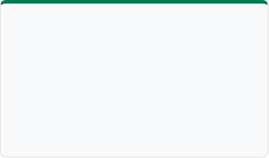
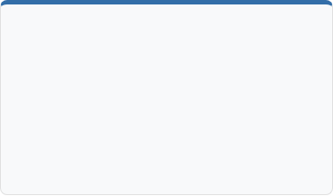


Project Deliverables
Source Code
Documentation
Final Product
Databricks Notebooks (Python), ADF Pipeline JSONs, ML Training Scripts.
Architecture Diagrams, Data Dictionary, API Specs, Final Report.
Interactive Power BI Dashboard connected to live Synapse views.
Timeline: All milestones completed. Ready for final handover.
11/30/25
22

Slide 24







Project Team
Nagat Osama
Ebrahim Ateff
Abdullah Mohamed
Merna Sameh
Data Engineer
Ingestion Pipelines
Data Engineer
Processing & Transformation
Team Lead
BI & Visualization
ML Engineer
AI Models & Forecasting
11/30/25
23

Slide 25
Questions?
Thank you for your attention.
Team 4 | Smart City Energy Project
11/30/25
24

Slide 26

Thank You!
Questions?
GitHub: https://github.com/nagatosamasaad
11/30/25
25

